Slide 1
Presentation brief for MCT’s
Title of presentation | "Working with Data
Presentation length | 120 minutes (including labs)
Audience | Data Scientists planning to operate machine learning workloads on Azure
Purpose | Introduce Datastores and how to create and use them Introduce Datasets and how to create and use them
(think) Student key takeaways | Datastores encapsulate a data source. Datasets are versioned entities that represent tabular or file data
(feel) Student desired mindset | Confident working with datastores Confident working with datasets
(do) Student outcomes | Create and manage datastores, and consume data from them in experiments Create and manage datasets, and consume data from them in experiments
More information | For course feedback, please use the MCT Forums

Slide 2

Module 4: Working with Data

Slide 3
Agenda
Working with Datastores
Working with Datasets

Slide 4



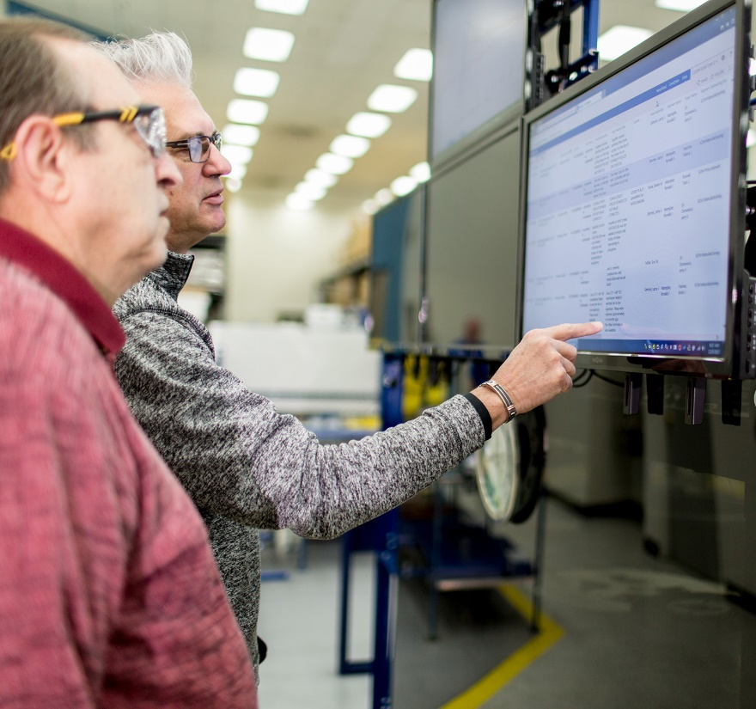






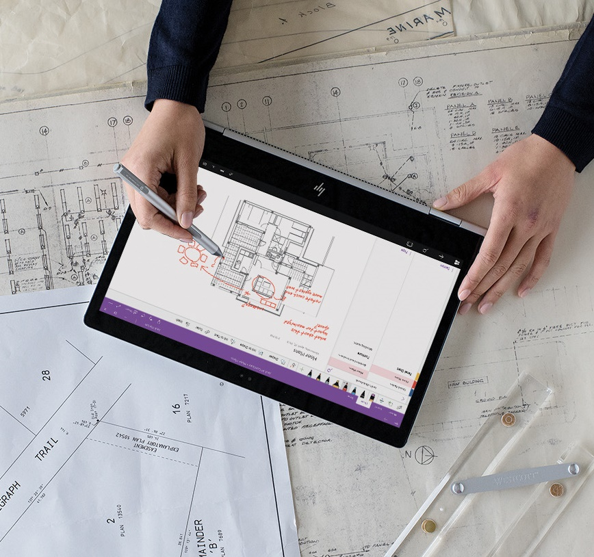


Lesson 1
Working with Datastores
Data
Cloud
AI

Slide 5





What are Datastores?
Abstractions for cloud data sources:
Azure Storage
Azure Data Lake
Azure SQL Database
Azure Databricks File System
Others
Enable data access from workspace
Upload/Download
Remote Mount

Slide 6
Adding Datastores to a Workspace
Add a datastore in Azure Machine Learning studio
Use the Datastore object in the SDK
from azureml.core import Workspace, Datastore
ws = Workspace.from_config()
# Register a new datastore
blob_ds = Datastore.register_azure_blob_container(workspace=ws,
datastore_name='blob_data',
container_name='data_container',
account_name='az_store_acct',
account_key='123456abcde789…')

Slide 7
Using Azure Blob and File Datastores
Work with a datastore directly to upload and download data:
Access data in an experiment script through a data reference parameter
blob_ds.upload(src_dir='/files', target_path='/data/files', overwrite=True, show_progress=True)
blob_ds.download(target_path='downloads', prefix='/data', show_progress=True)
# code to submit experiment
data_ref = blob_ds.path('data/files').as_download(path_on_compute='training_data')
estimator = SKLearn(source_directory='experiment_folder',
entry_script='training_script.py'
compute_target='local',
script_params = {'--data_folder': data_ref})
# code in training script
parser = argparse.ArgumentParser()
parser.add_argument('--data_folder', type=str, dest='data_folder')
args = parser.parse_args()
data_files = os.listdir(args.data_folder)

Slide 8
Lab 4A
Working with Datastores
https://aka.ms/msl-dp100

Slide 9
Lesson Review
Complete the Review Questions

Slide 10
Lesson 2
Working with Datasets
Data
Cloud
AI

Slide 11


What are Datasets?
Versioned data objects for experiments
Generally based on datastore contents
Two types of Dataset:
Tabular Datasets: Easy conversion to Pandas dataframe format
File Datasets: Collection of file paths for unstructured data

Slide 12
Creating and Registering Datasets
Add a dataset in Azure Machine Learning studio
Use the Dataset object in the SDK
from azureml.core import Dataset
# Create and register a tabular dataset
csv_paths = [(blob_ds, 'data/files/current_data.csv'),(blob_ds, 'data/files/archive/*.csv')]
tab_ds = Dataset.Tabular.from_delimited_files(path=csv_paths)
tab_ds = tab_ds.register(workspace=ws, name='csv_table')
# Retrieve registered dataset
csv_ds = ws.datasets['csv_table'] # Using workspace datasets attribute
from azureml.core import Dataset
# Create and register a file dataset
file_ds = Dataset.File.from_files(path=(blob_ds, 'data/files/images/*.jpg'))
file_ds = file_ds.register(workspace=ws, name='img_files')
# Retrieve registered dataset
img_ds = Dataset.get_by_name(ws, 'img_files') # using Dataset get_by_name method

Slide 13
Reading Data from Datasets
Work with a dataset directly:
Access data in an experiment script through a named input
df = tab_ds.to_pandas_dataframe()
for file_path in file_ds.to_path():
print(file_path)
# code to submit experiment
estimator = SKLearn( source_directory='experiment_folder',
entry_script='training_script.py'
compute_target='local',
inputs=[tab_ds.as_named_input('csv_data')], # Pass the Dataset as an input…
pip_packages=['azureml-dataprep[pandas]'] # …so dataprep package is needed
)
# code in training script
run = Run.get_context()
data = run.input_datasets['csv_data'].to_pandas_dataframe()

Slide 14
Dataset Versioning
Create a new version of an existing dataset
Specify a version to retrieve
# add .png files to dataset definition
img_paths = [(blob_ds, 'data/files/images/*.jpg'),(blob_ds, 'data/files/images/*.png')]
file_ds = Dataset.File.from_files(path=img_paths)
file_ds = file_ds.register(workspace=ws, name='img_files', create_new_version=True)
ds = Dataset.get_by_name(workspace=ws, name='img_files', version=2)

Slide 15
Lab 4B
Working with Datasets
https://aka.ms/msl-dp100

Slide 16
Lesson Review
Complete the Review Questions

